Slide 1
ML Lab basics
By K. Sai Karthik

Slide 2
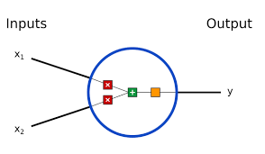
What is Machine Learning?
Machine learning is the study of computer algorithms that improve automatically through experience. It is seen as a part of artificial intelligence.

Slide 3
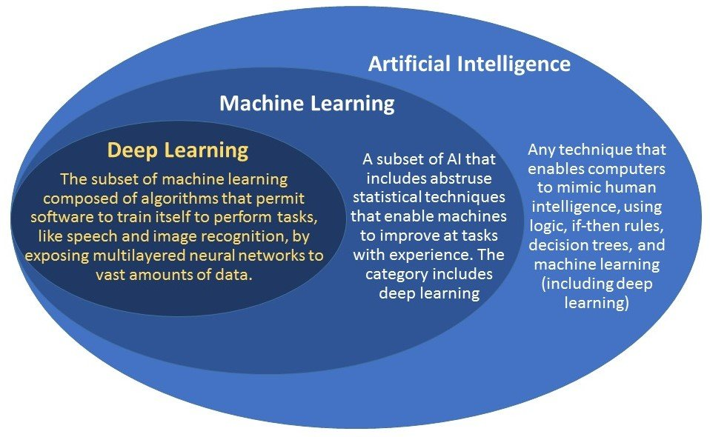
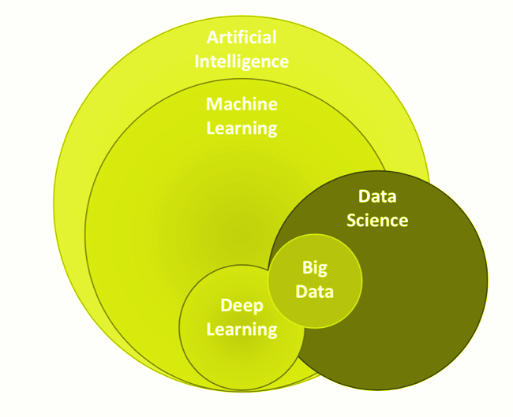
Venn diagram

Slide 4
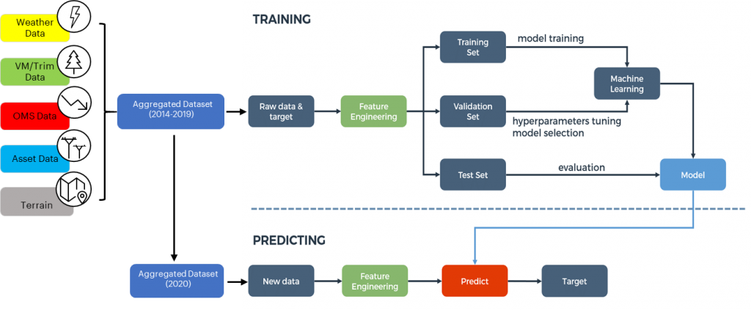

Slide 5
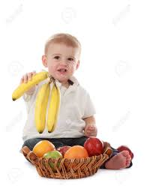
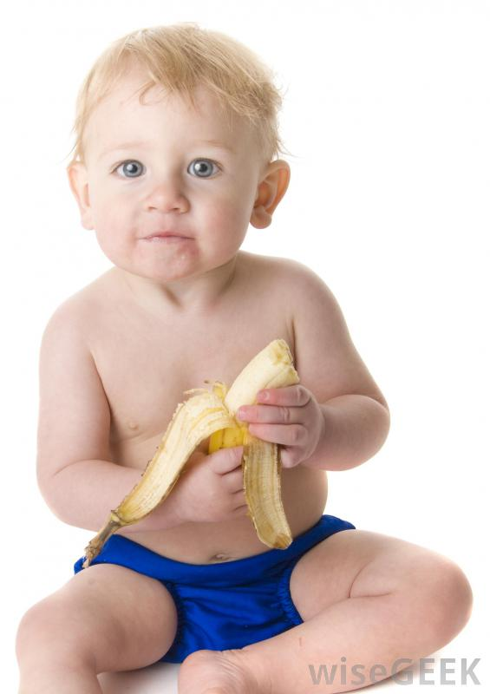
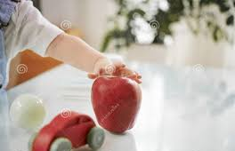
Baby Example

Slide 6
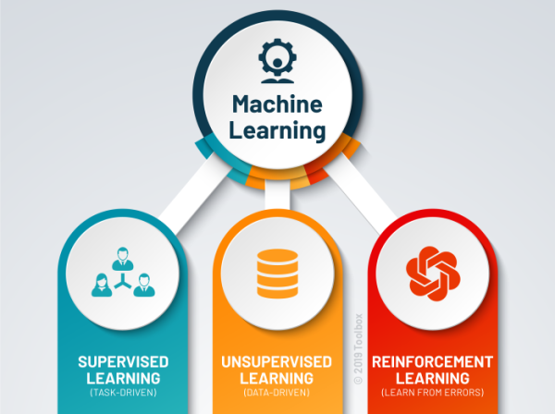
Types of Machine Learning

Slide 7
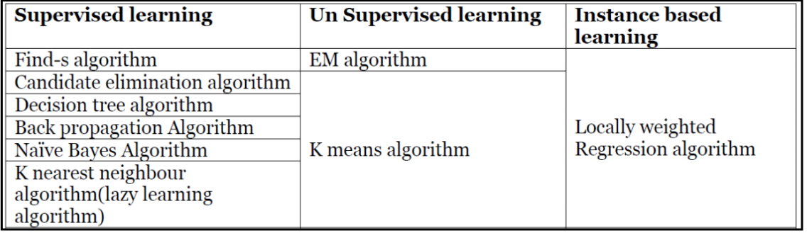
Models based on our syllabus

Slide 8
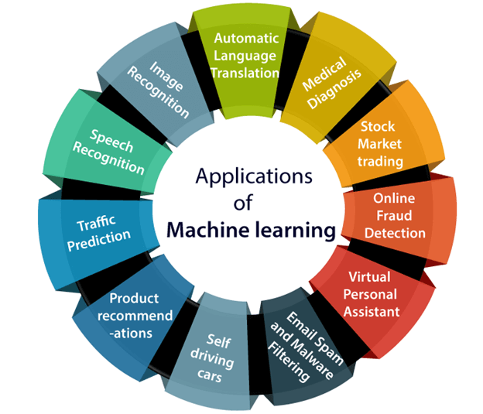
Applications of Machine Learning

Slide 9





Required Modules
CSV
pygmpy
math

